Slide 1
BANA 7038 Final Project
Developer Salary Survey Data from StackOverflow 2018
Dong, Juntao (M10453134)
Frankenhoff, Brenda (M01775924)
February 28, 2019

Slide 2
Project goals
Data from 2018 StackOverflow developer salary survey
final survey is at https://insights.stackoverflow.com/survey/2018/#overview)
Data files downloaded from https://www.kaggle.com/stackoverflow/stack-overflow-2018-developer-survey#survey_results_public.csv
Develop predictive model to estimate salary of a given developer with specific years of experience and specific technical skills.
Languages
Platforms
Databases
Frameworks

Slide 3
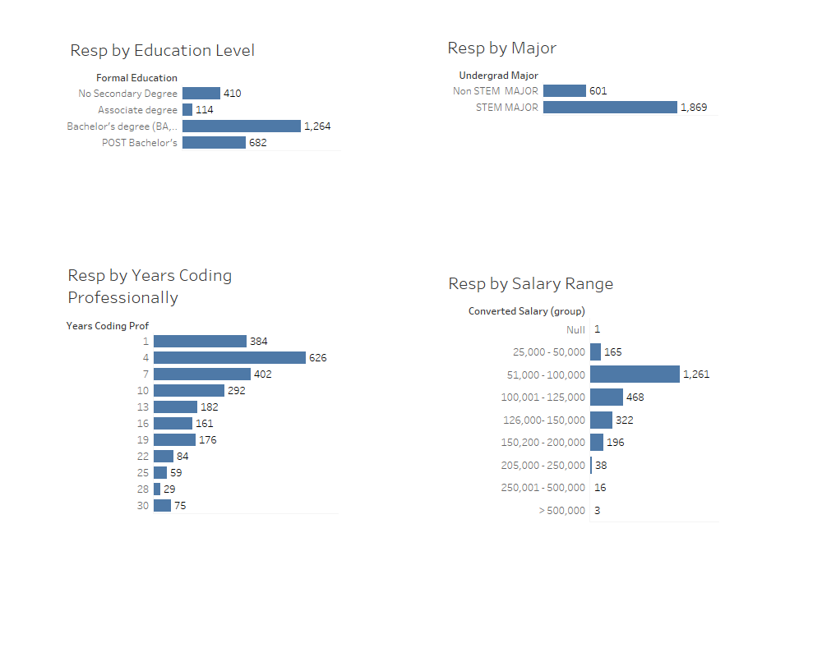
Data analysis/Cleansing
Data analysis/Cleansing

Slide 4
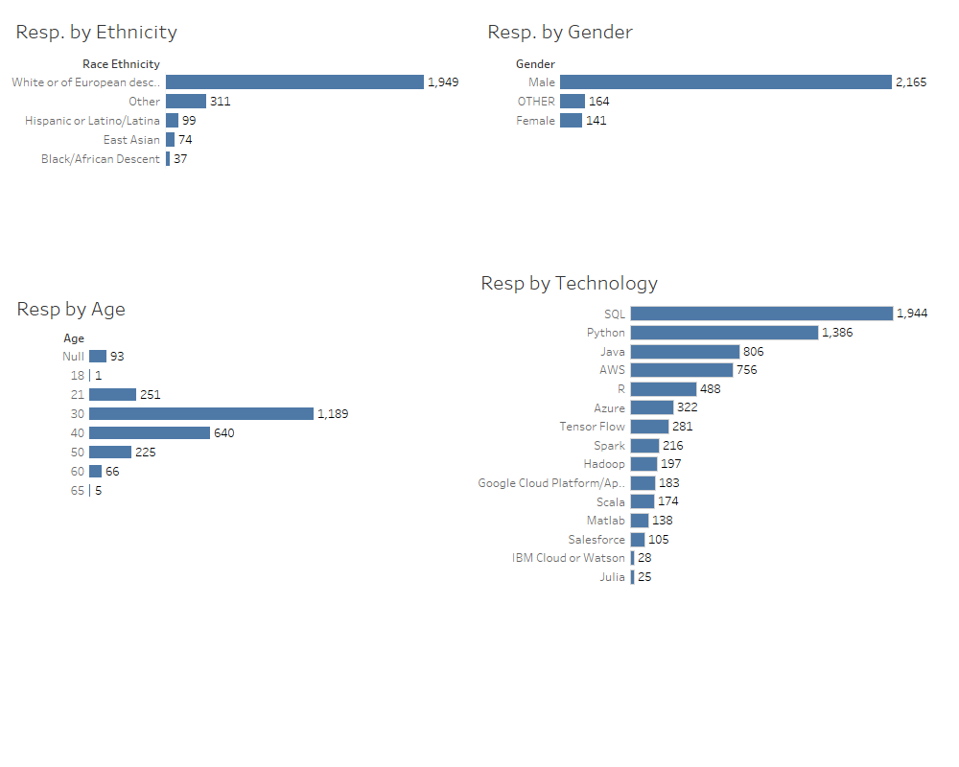
Data analysis/Cleansing
Data analysis/Cleansing

Slide 5
Data analysis/Cleansing
Data analysis/Cleansing

Slide 6
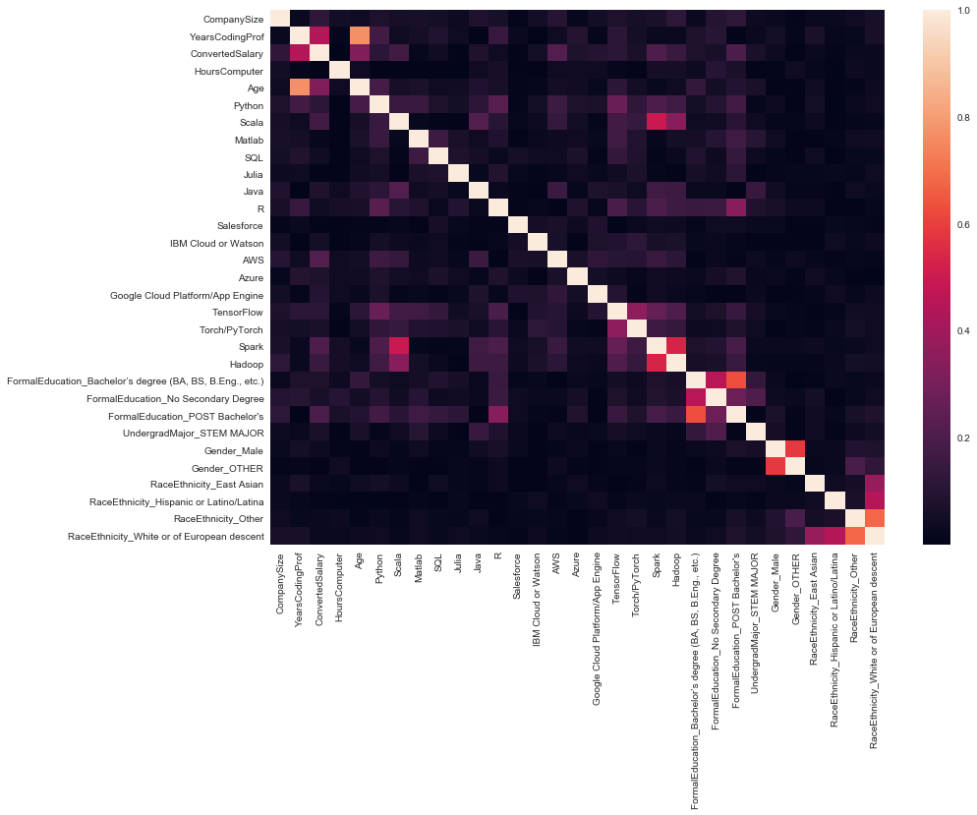
Data analysis/Cleansing
Data analysis/Cleansing

Slide 7
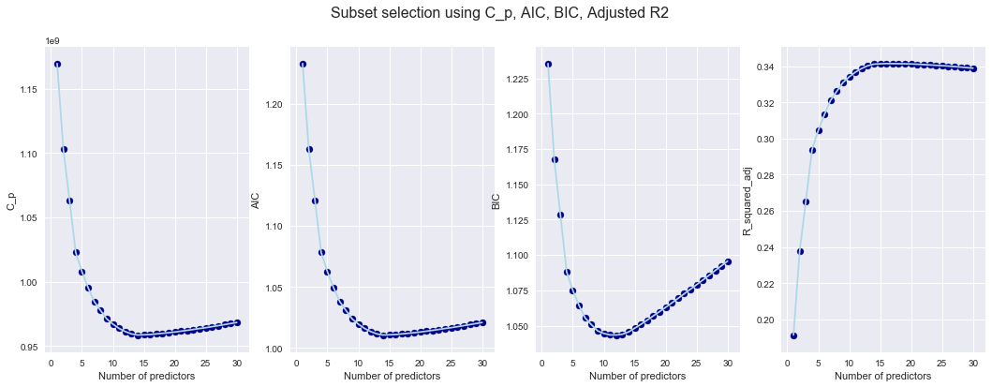
Model Development
Forward Stepwise Selection Mallow’s C_{p}, AIC, BIC and adjusted R² are introduced to
select the number of features to be used.

Slide 8
Model Development
Linear Regression
Ridge Regression
Polynomial Regression
Decision Tree Classification
K Nearest Neighbor Classification

Slide 9
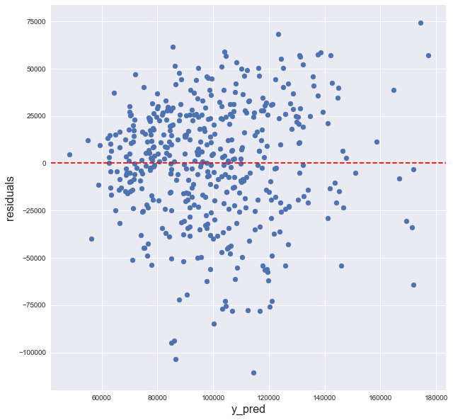
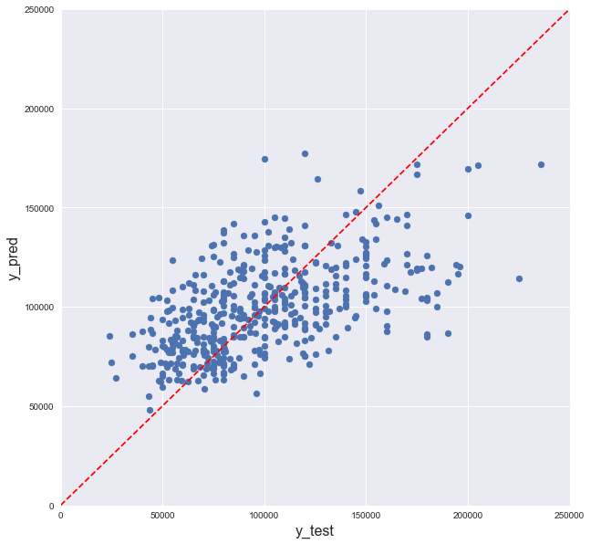
Linear Regression
MSE = 955055604
(a) (b)
Figure 2.3 (a) Scatter plot of residual against fitted values from linear regression (b) Scatter plot of linear fitted values against true values

Slide 10
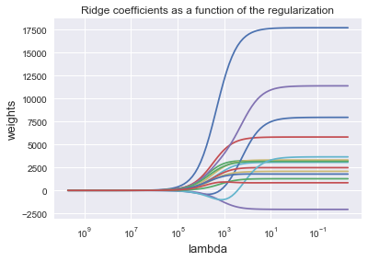
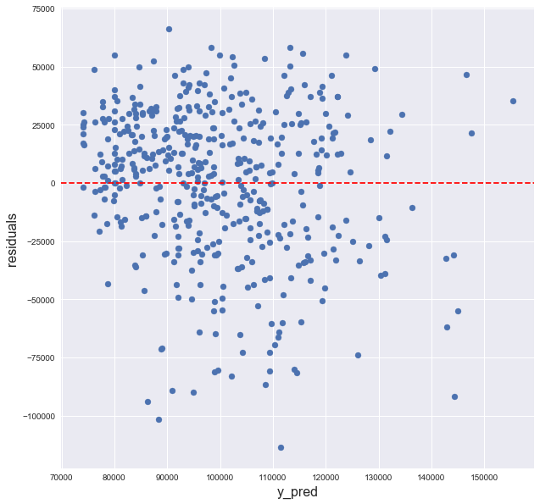
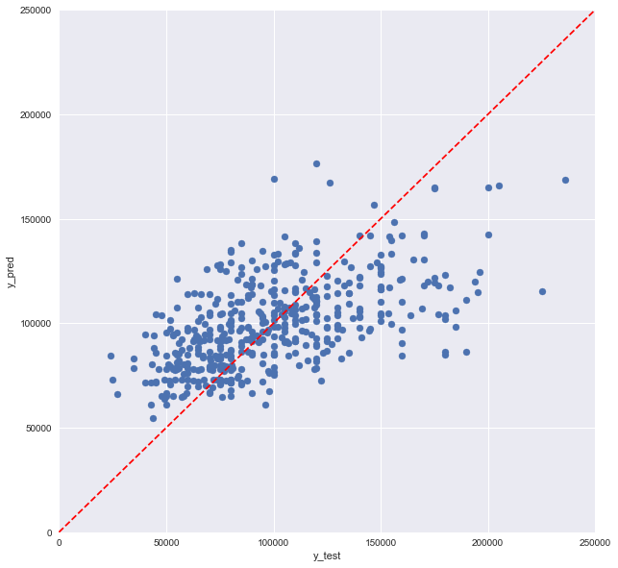
Ridge Regression
λ = 10 MSE = 975182423
a.
b.
Figure 2.4 Ridge coefficients as a function of the regularization
Figure 2.5 (a) Scatter plot of residual against fitted values from ridge regression with λ =10 (b) Scatter plot of ridge fitted values against true values

Slide 11
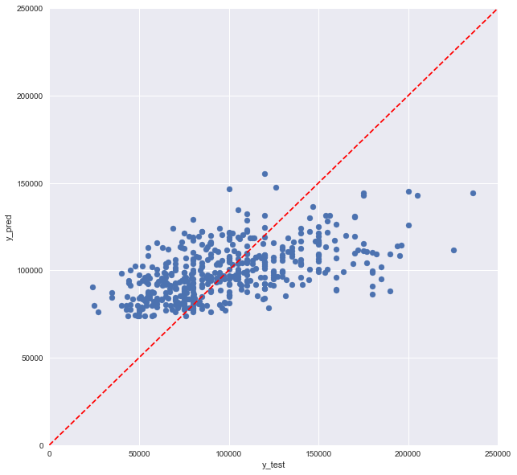
Ridge Regression
λ = 100 MSE = 1026741817
a.
b.
Figure 2.4 Ridge coefficients as a function of the regularization
Figure 2.5 (a) Scatter plot of residual against fitted values from ridge regression with λ =100 (b) Scatter plot of ridge fitted values against true values

Slide 12
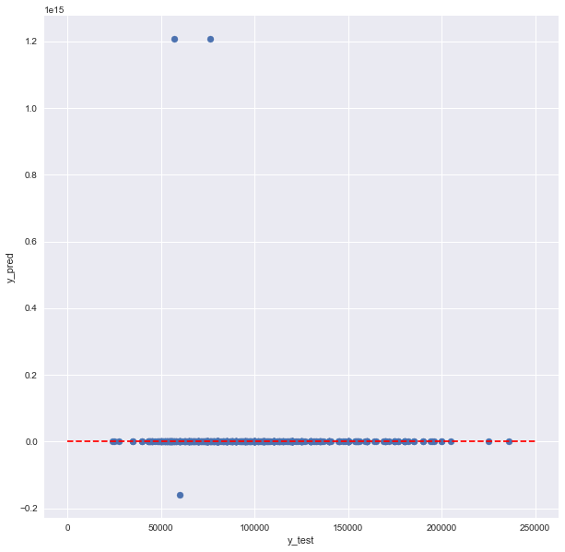
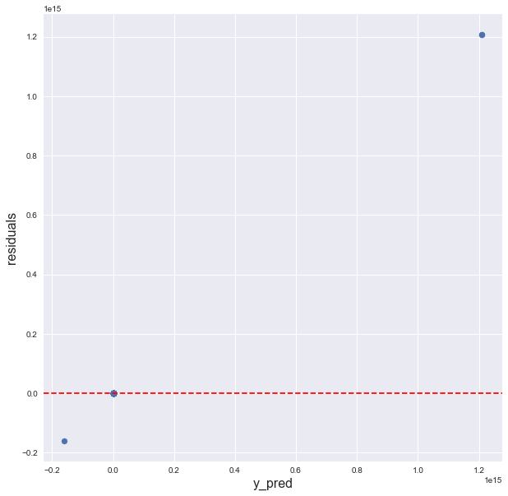
Polynomial Regression
Figure 2.6 (a) Scatter plot of residual against fitted values from ridge regression with λ =100 (b) Scatter plot of ridge fitted values against true values

Slide 13
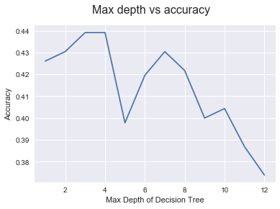
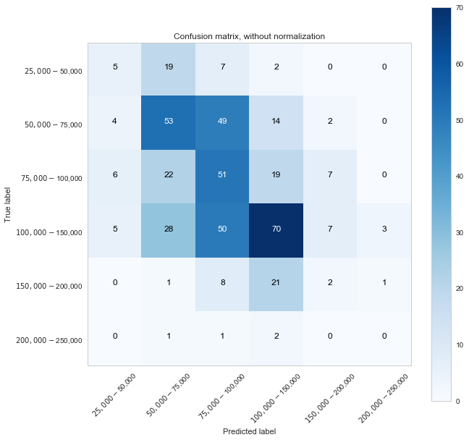
Decision Tree Classification
Figure 2.7 Line plot of accuracy of the decision tree classification against max depth of the decision tree
Figure 2.8 Confusion matrix of decision tree classification with max depth of 3

Slide 14
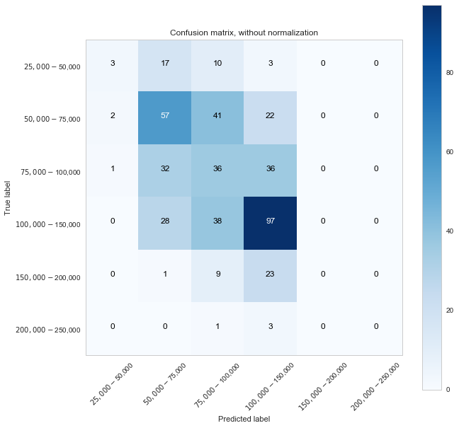
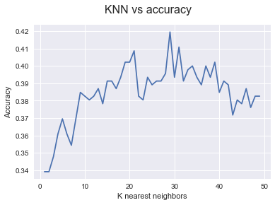
K Nearest Neighbor Classification
Figure 2.9 Accuracy of the KNN
classification against the K value
Figure 2.10 Confusion matrix of KNN
classification with K of 29

Slide 15
Observations
Best model selection:
Model name | Simple linear regression | Ridge regression λ = 10 | Ridge regression λ = 100 | Polynomial regression
MSE | 9.55x10⁸ | 9.75 x10⁸ | 1.03 x10⁹ | 7x10²⁸
Model name | Decision tree Max_depth=3 | K nearest neighbors K=29
Accuracy | 44% | 42%

Slide 16
Conclusion
Data sample quality is key to being able to develop a predictive model.
Survey data did not show a strong relationship between experience nor technical skill sets in relationship to salary. (geography has a big influence and this was not in the survey)
StackOverflow user base appears to be between 30 – 40, male, and non-minority, so is not reflective (we hope) of the industry demographics.

